Slide 1
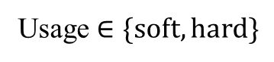
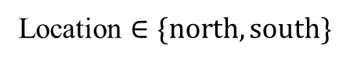
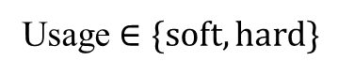
Class diagram
Part1
Failure model1
Truck
Part2
Failure model2
Usage $∈\{soft, hard\}$
Part1
Failure model1
Dealer
Truck
Part2
Failure model2
Location $∈\{north, south\}$
Usage $∈\{soft, hard\}$
No. of dealers = 2
No. of trucks = 30
No. of parts = 30
Notes:
This slide shows the class diagram of the current simulator.
At the top, I define dealer class.
Its location is defined as either north or south. Currently, dealer number is set to 2.
The remaining structure is same as conventional one.
Each dealer manages multiple trucks.
And each Truck has multiple types of parts. And each part has a failure model, which is commonly shared among parts of same types.

Slide 2
Progress Report
2025-11-12

Slide 3
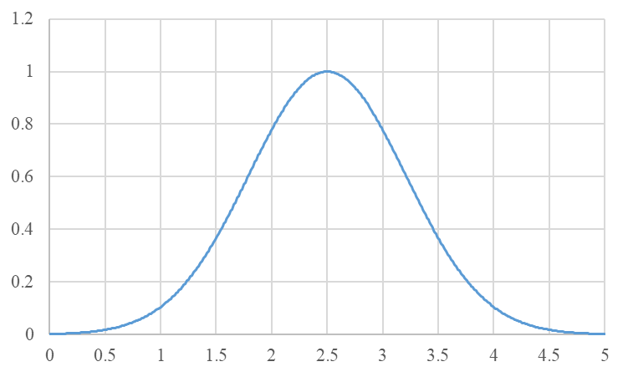
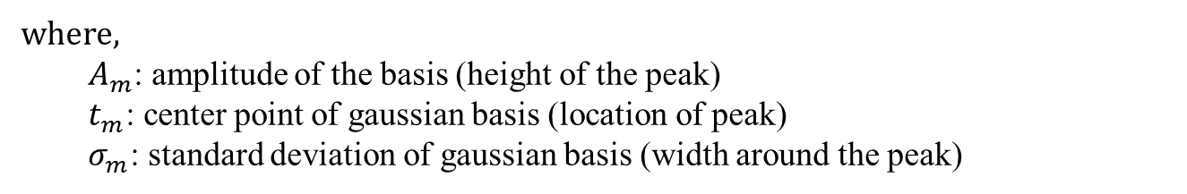
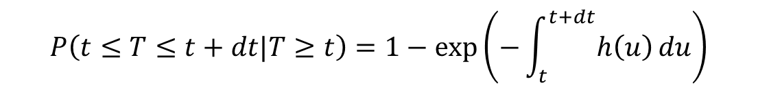
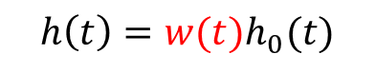
Seasonality
Hazard function-based formulation:
$$P\left(t≤T≤t+dt|T≥t\right)=1−exp\left(−\int_{t}^{t+dt}{h\left(u\right)}du\right)⁡$$
$$h\left(t\right)=w(t)h_{0}(t)$$
where $w(t)$ represents the seasonal coefficient corresponding to each day or month.
$w\left(t\right)$: Sum of radial basis function (RBF)
$$w\left(t\right)=\sum_{m=1}^{M}{A_{m}exp⁡(−\frac{{\left\|t_{m}−t\right\|}^{2}}{σ_{m}^{2}})}=\sum_{m=1}^{M}{A_{m}exp⁡(−\frac{{\left\|max⁡(\left|t_{m}−t\right|,T−\left|t_{m}−t\right|\right\|}^{2}}{σ_{m}^{2}})}$$
where,
$A_{m}$: amplitude of the basis (height of the peak)
$t_{m}$: center point of gaussian basis (location of peak)
$σ_{m}$: standard deviation of gaussian basis (width around the peak)
Notes:
This slide shows how to model seasonality.
As discussed in the previous meeting,
we multiply h(t) by the seasonal coefficient corresponding to each day or month.
The key point is how to design this coefficient.
And I propose it as a sum of radial basis functions, or RBF.
As you know, RBF forms a bell-shaped curve.
the coefficient is constructed by summing up multiple RBF.
Each RBF is defined by 3 parameters, A, t and sigma.
Am is amplitude of the basis, meaning the height of peak.
Tm is center point of the basis, meaning the height of peak.
Sigma is standard deviation of the basis, meaning the width around peak.
And by summing up these functions,
we can draw seasonality curve based on each location.

Slide 4
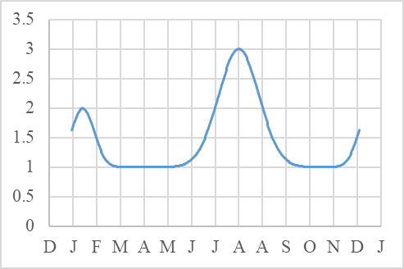
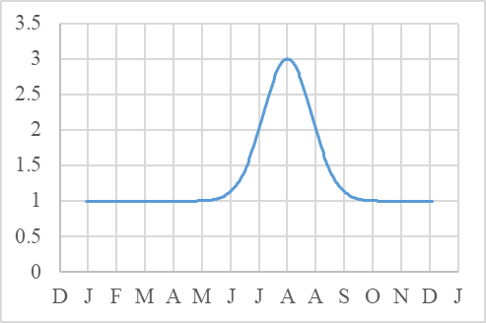
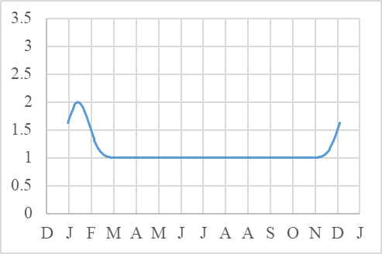
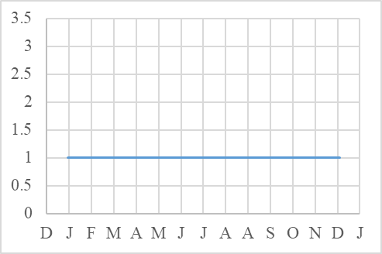
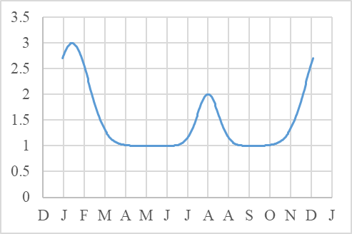
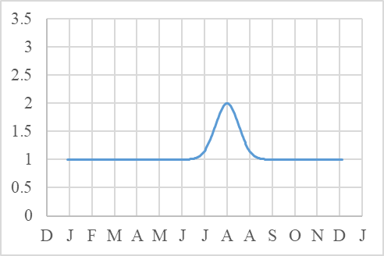
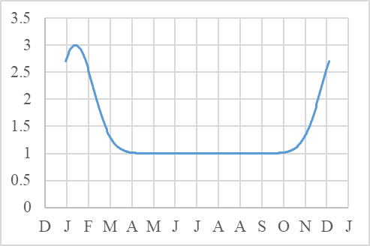
Behavior of $w\left(t\right)$
Southern area: $t_{m}=\left[1st Aug \left(summer\right), 15th Jan (winter)\right],A_{m}=\left[2,1\right],σ_{m}=\left[25, 15\right]$
Both-season
Summer
Winter
No-season
Northern area: $t_{m}=\left[1st Aug \left(summer\right), 15th Jan (winter)\right],A_{m}=\left[1,2\right],σ_{m}=\left[15, 25\right]$
Both-season
Summer
Winter
No-season
Notes:
As well,
Several types of seasonality can be modeled, like this.
It includes both-season, summer-only, winter-only, and no-season patterns.
Then, I simulated one year of demand
using these four types of seasonality for the two locations.

Slide 5
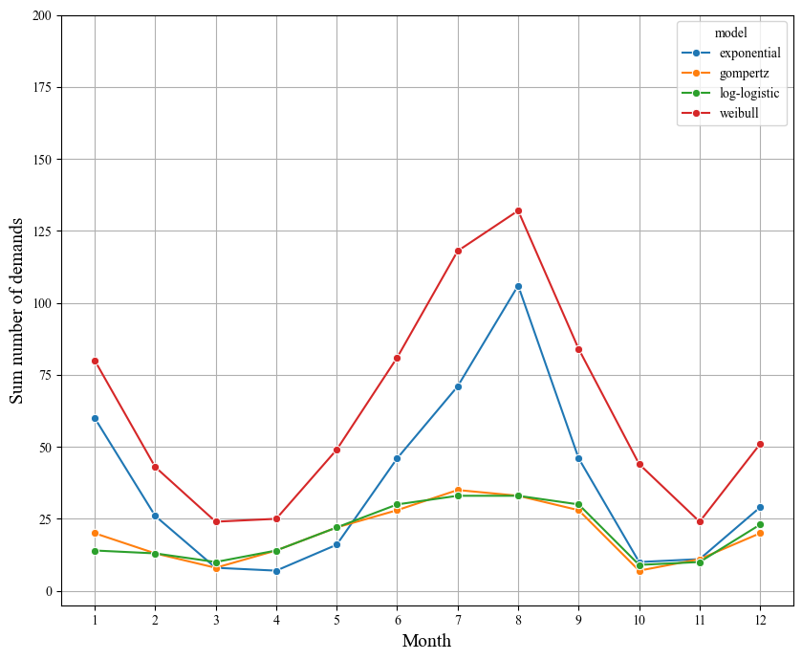
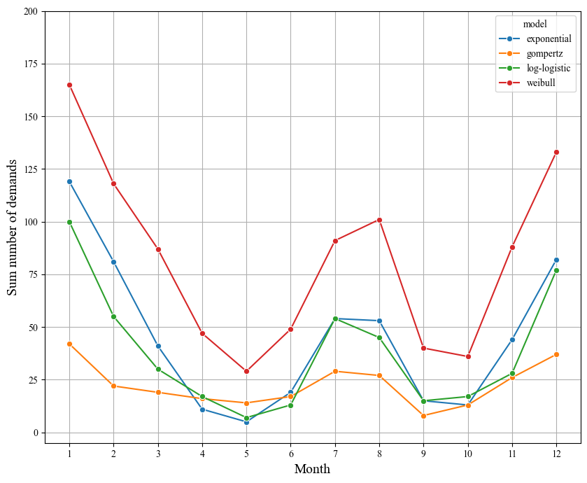
Simulated demand using several models
Part1: Both-seasons parts
Dealer1 (southern area)
Dealer2 (northern area)
exponential
exponential
weibull
weibull
log-logistic
log-logistic
gompertz
gompertz

Slide 6
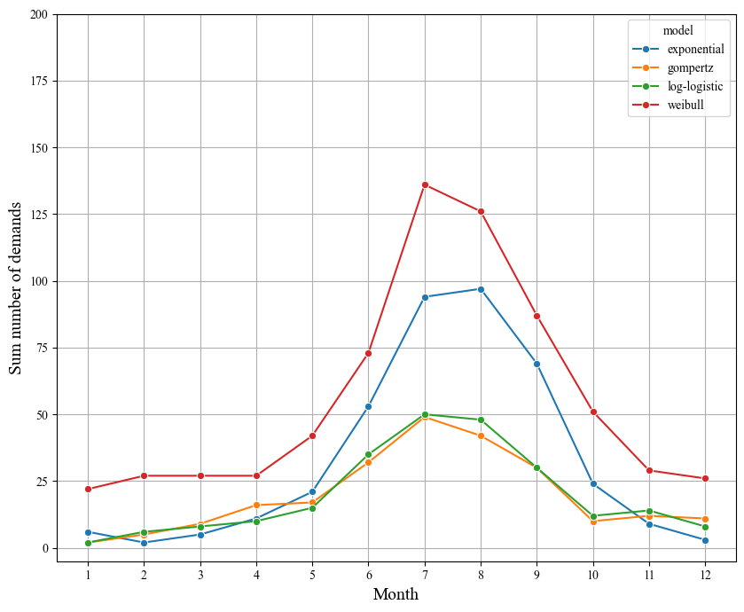
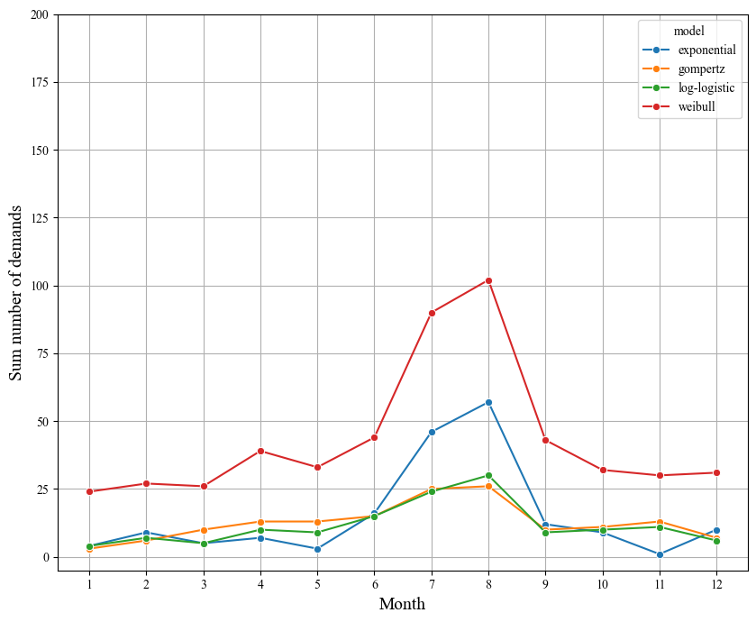
Simulated demand using several models
Part2: Summer-season parts
Dealer1 (southern area)
Dealer2 (northern area)
exponential
exponential
weibull
weibull
log-logistic
log-logistic
gompertz
gompertz

Slide 7
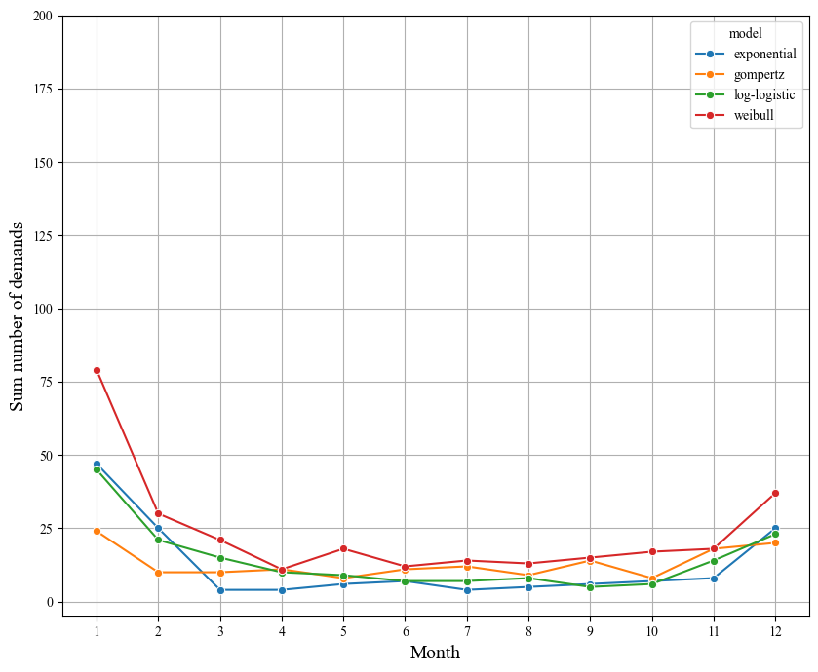
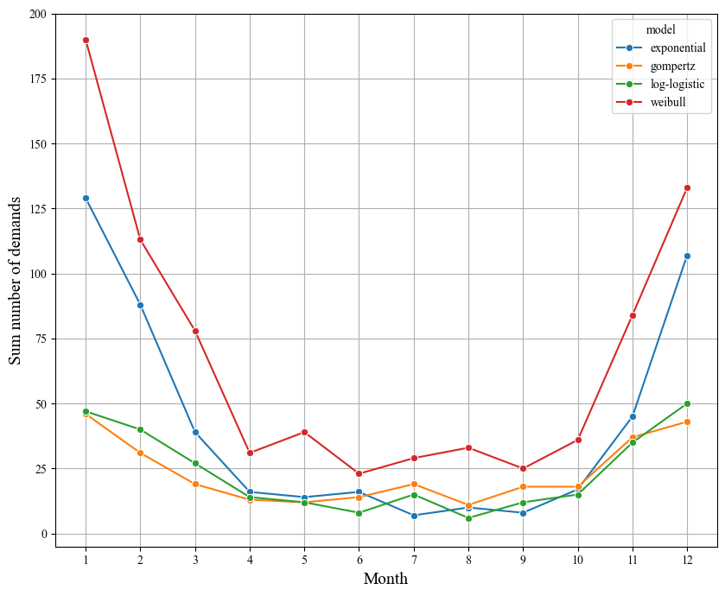
Simulated demand using several models
Part3: Winter-season parts
Dealer1 (southern area)
Dealer2 (northern area)
exponential
exponential
weibull
weibull
log-logistic
log-logistic
gompertz
gompertz

Slide 8
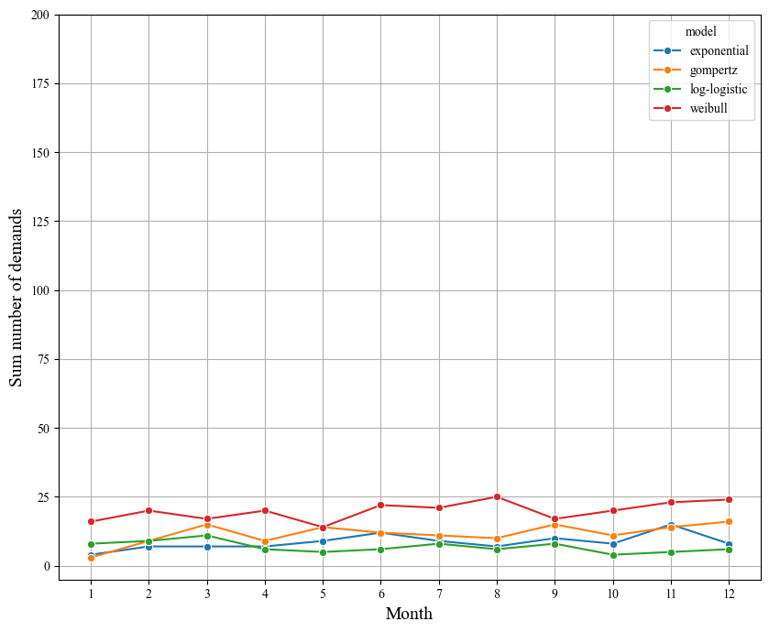
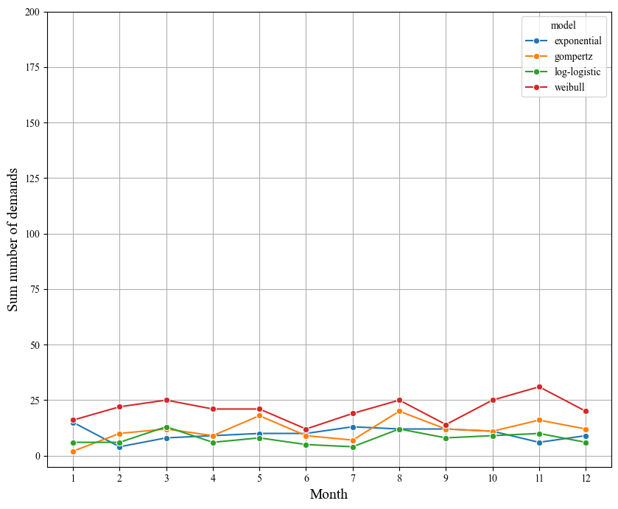
Simulated demand using several models
Part4: No-season parts
Dealer1 (southern area)
Dealer2 (northern area)
exponential
exponential
weibull
weibull
log-logistic
log-logistic
gompertz
gompertz

Slide 9
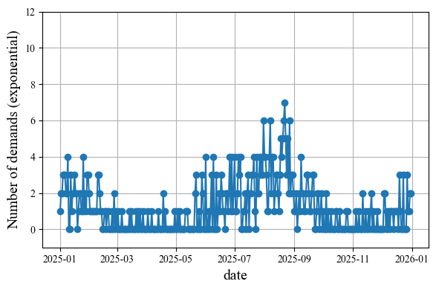
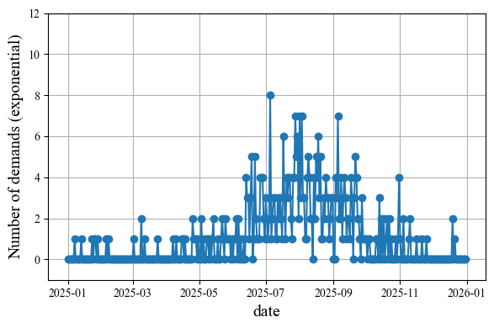
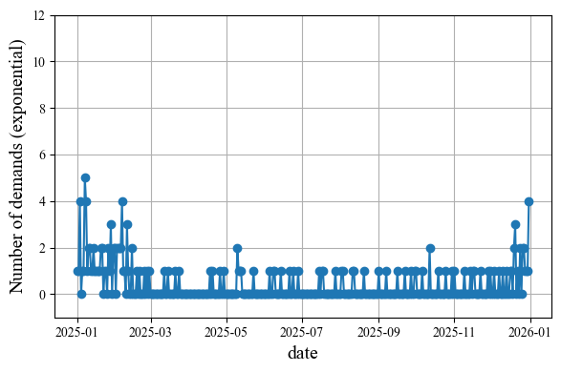
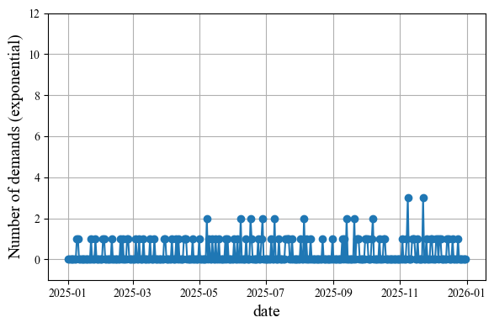
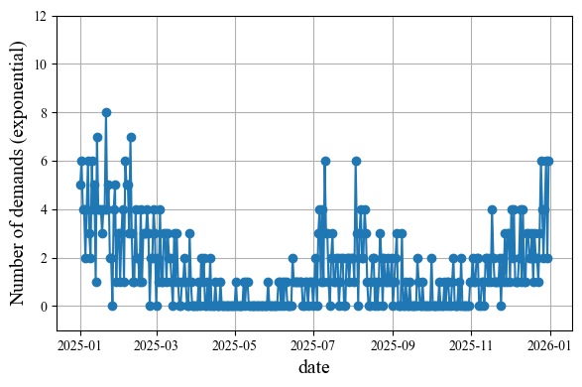
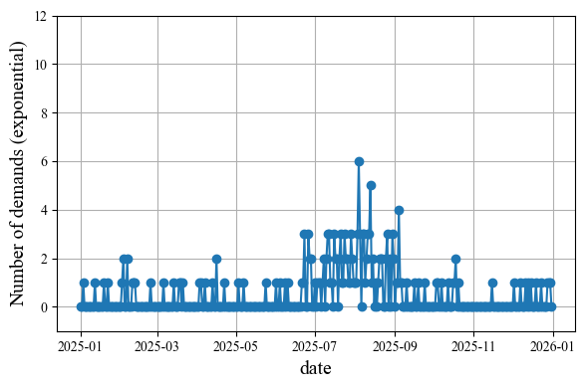
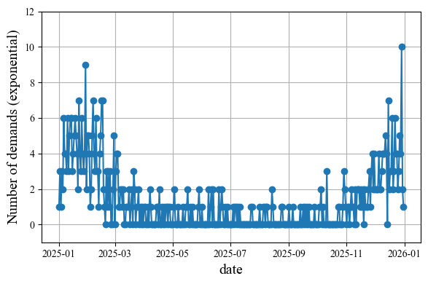
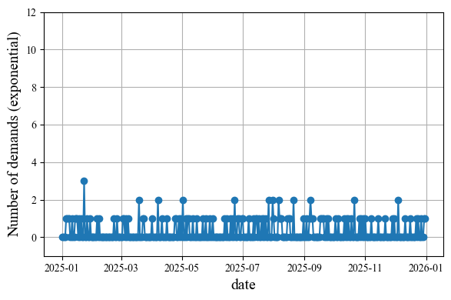
Simulated Demand Data (Exponential model)
Dealer1 (location: southern area)
Part1 (both-seasons)
Part2 (summer)
Part3 (winter)
Part4 (no-season)
Dealer2 (location: northern area)
Part1 (both-seasons)
Part2 (summer)
Part3 (winter)
Part4 (no-season)

Slide 10
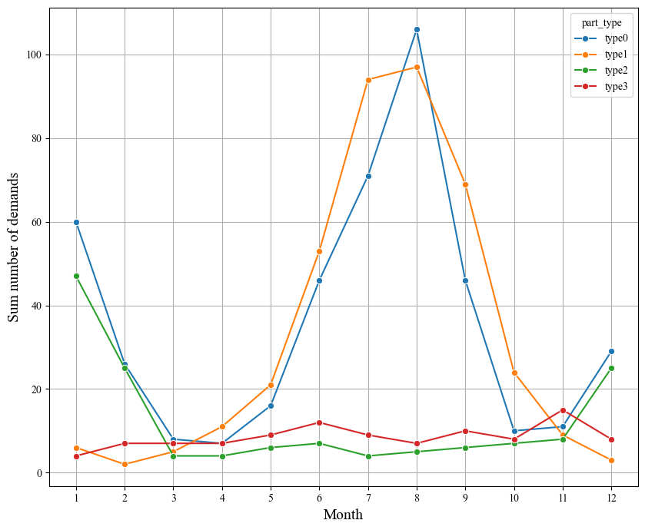
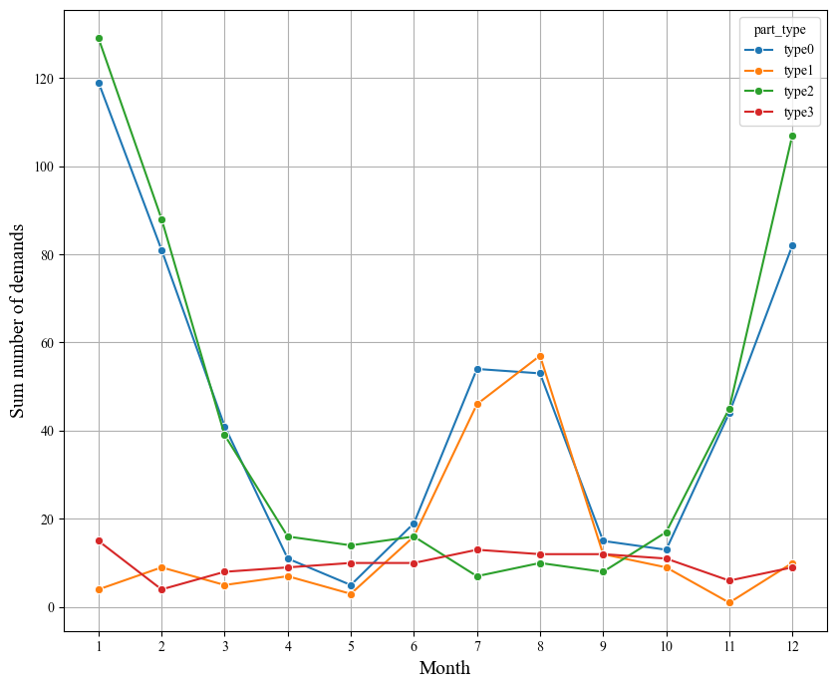
Simulated Demand Data (Exponential model)
Dealer1 (location: southern area)
Dealer2 (location: northern area)
Part1 (both)
Part1 (both)
Part2 (summer)
Part2 (summer)
Part3 (winter)
Part3 (winter)
Part4 (no)
Part4 (no)

Slide 11
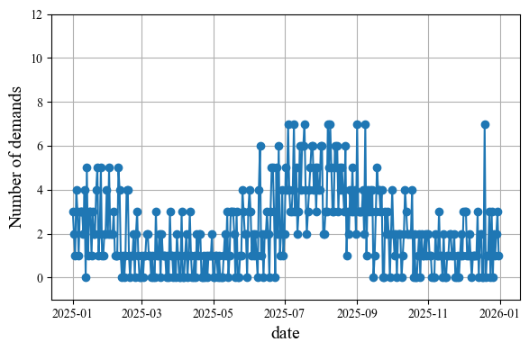
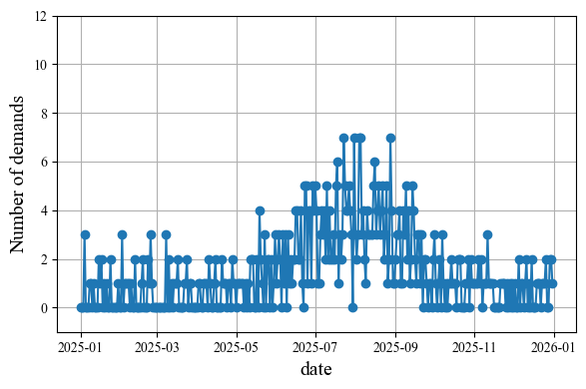
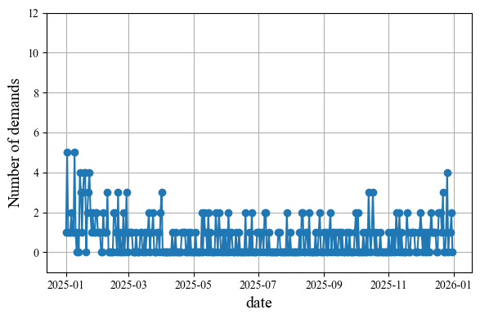
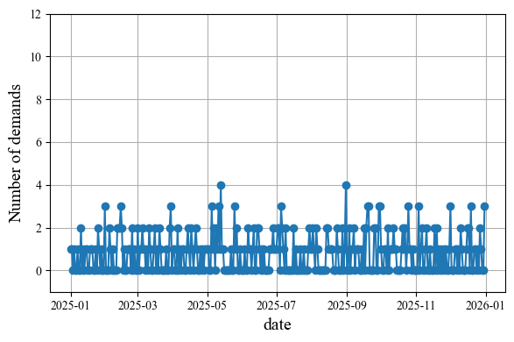
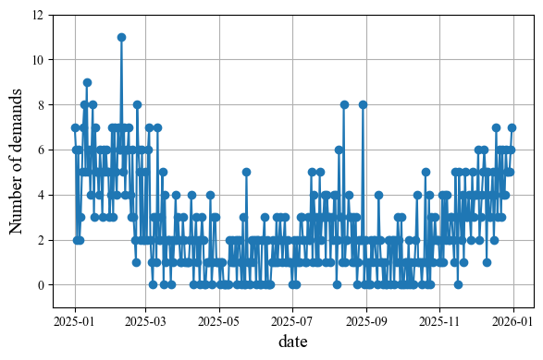
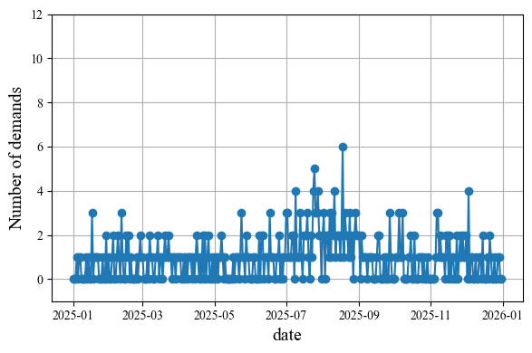
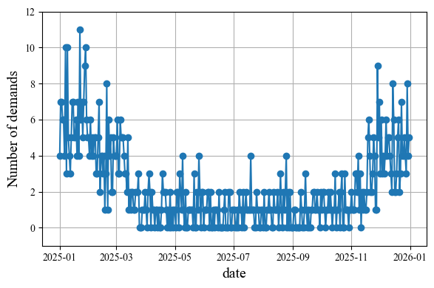
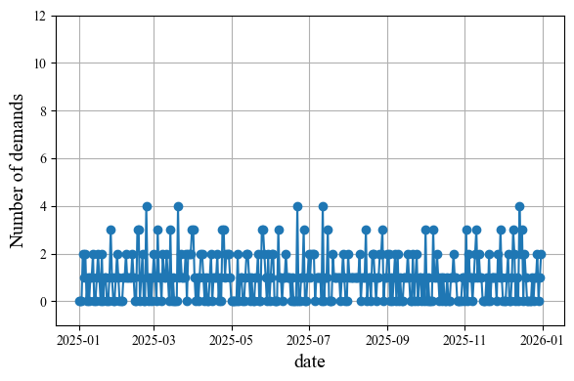
Simulated Demand Data (Weibull model)
Dealer1 (location: southern area)
Part1 (both-seasons)
Part2 (summer)
Part3 (winter)
Part4 (no-season)
Dealer2 (location: northern area)
Part1 (both-seasons)
Part2 (summer)
Part3 (winter)
Part4 (no-season)

Slide 12
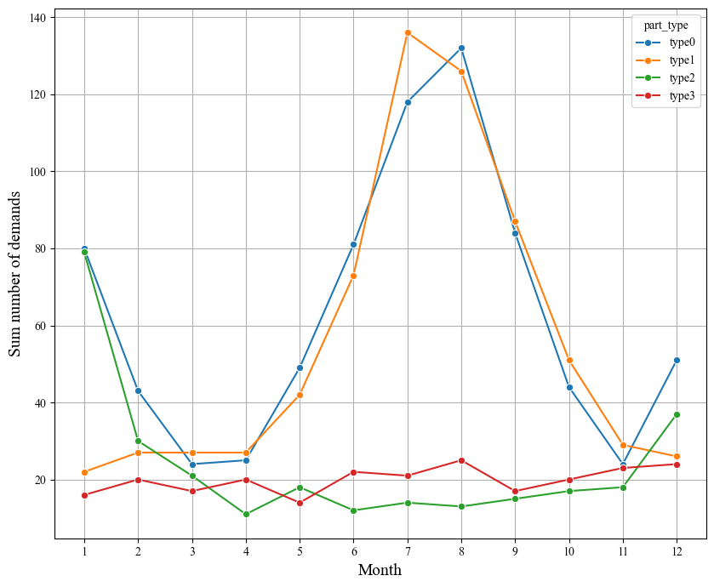
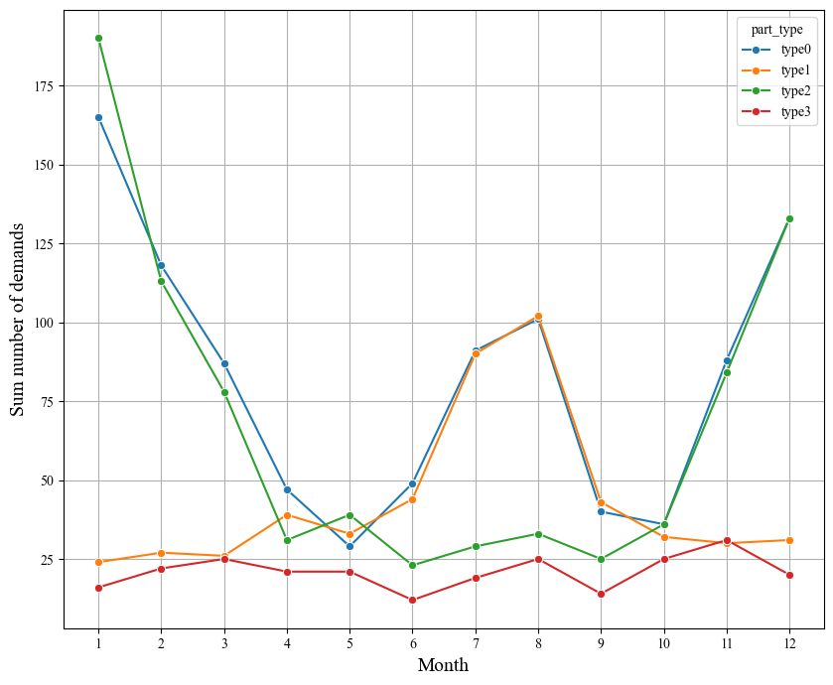
Simulated Demand Data (Weibull model)
Dealer1 (location: southern area)
Dealer2 (location: northern area)
Part1 (both)
Part1 (both)
Part2 (summer)
Part2 (summer)
Part3 (winter)
Part3 (winter)
Part4 (no)
Part4 (no)

Slide 13
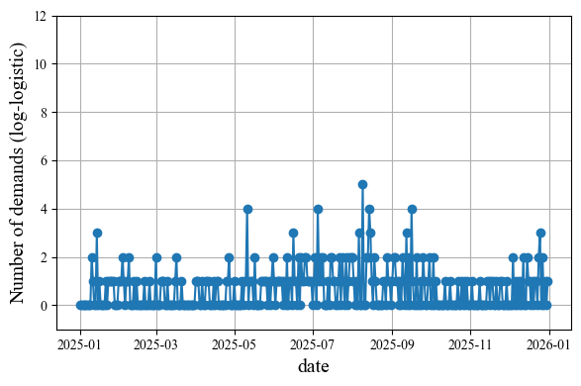
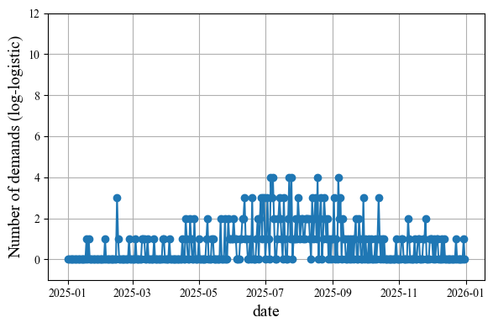
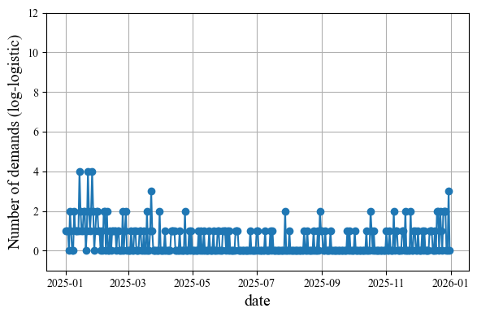
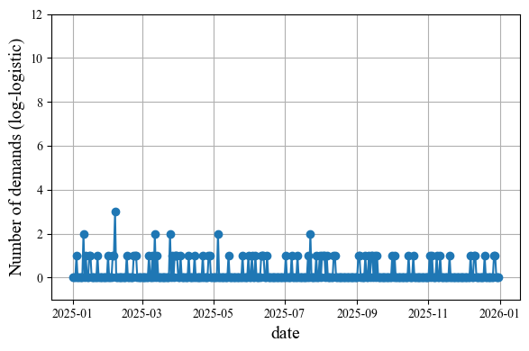
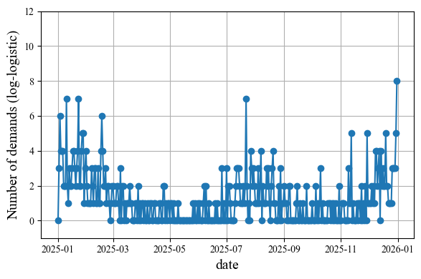
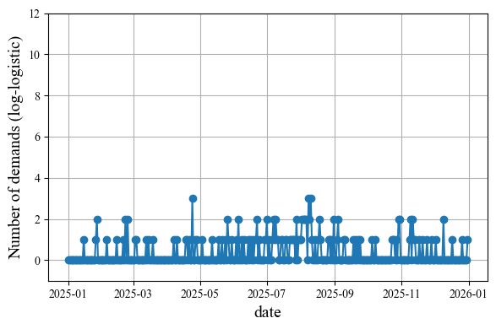
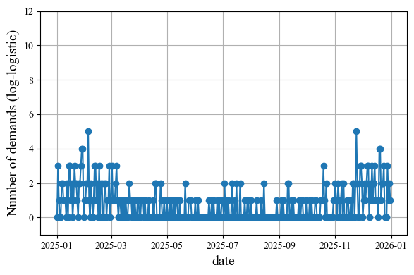
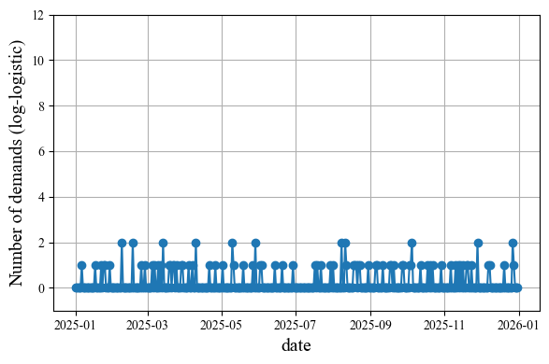
Simulated Demand Data (Log-logistic model)
Dealer1 (location: southern area)
Part1 (both-seasons)
Part2 (summer)
Part3 (winter)
Part4 (no-season)
Dealer2 (location: northern area)
Part1 (both-seasons)
Part2 (summer)
Part3 (winter)
Part4 (no-season)

Slide 14


Simulated Demand Data (Log-logistic model)
Dealer1 (location: southern area)
Dealer2 (location: northern area)
Part1 (both)
Part1 (both)
Part2 (summer)
Part2 (summer)
Part3 (winter)
Part3 (winter)
Part4 (no)
Part4 (no)

Slide 15








Simulated Demand Data (Gompertz model)
Dealer1 (location: southern area)
Part1 (both-seasons)
Part2 (summer)
Part3 (winter)
Part4 (no-season)
Dealer2 (location: northern area)
Part1 (both-seasons)
Part2 (summer)
Part3 (winter)
Part4 (no-season)

Slide 16


Simulated Demand Data (Gompertz model)
Dealer1 (location: southern area)
Dealer2 (location: northern area)
Part1 (both)
Part1 (both)
Part2 (summer)
Part2 (summer)
Part3 (winter)
Part3 (winter)
Part4 (no)
Part4 (no)

Slide 17
Demand Prediction
Model: XGBoost
Trained using 2 years demand data for multiple parts showing different seasonality across all dealers
Predicts demands for the following year, for each part at each dealer
Target variable: Daily number of demands
Feature datasets: Two types
Basic features
Day-of-the-year: sequential day index within a year (1-365)
Month
Part ID
Dealer ID
Basic + Historical features
Historical data calculated over past p days: mean, median, standard deviation (std) of demands in the past days
Zaro-cumulative: number of consecutive days with zero-demand before the current day
Lag demand: demand values from each of the past n days
Notes:
And I performed demand prediction for the previous simulated data by XGBoost.
Specifically,
I trained model using 2 years demand data for multiple parts showing distinct seasonality across all dealers
And predicts demands for the following year, for each part at each dealer
Namely, The target variable is the daily number of demands.
As the feature datasets, I used 2 types.
The first is the Basic feature set, which includes the day of the year, month, part ID, and dealer ID.
The second is the Basic plus Historical feature set,
which additionally includes historical data calculated over the past $p$days — such as mean, standard deviation, and median of demand — as well as zero-cumulative and lag-based features.
Then, I trained two types of models using these two different feature sets.

Slide 18


Results (Exponential model, Part1: Both-seasons)
Dealer1 (southern area)
Simulated demand
Basic features
Basic +
Historical features
Dealer2 (northern area)
Simulated demand
Basic features
Basic +
Historical features
Notes:
This slide shows the prediction results for parts with both-season seasonality in each dealer.
Blue curve shows the simulated demand.
Orange curve shows predicted demand by the model using the basic features.
Green curve shows prediction by the model using the basic + historical features.
As you can see, both models successfully captured seasonal trend.
And, compared to the basic-feature model,
the model with historical features shows daily variations.

Slide 19


Results (Exponential model, Part2: summer)
Dealer1 (southern area)
Simulated demand
Basic features
Basic +
Historical features
Dealer2 (northern area)
Simulated demand
Basic features
Basic +
Historical features
Notes:
This slide shows the prediction results for parts with summer seasonality in each dealer.
Similarly, both models successfully captured the seasonal trend.

Slide 20


Results (Exponential model, Part3: winter)
Dealer1 (southern area)
Simulated demand
Basic features
Basic +
Historical features
Dealer2 (northern area)
Simulated demand
Basic features
Basic +
Historical features
Notes:
This slide shows the prediction results for parts with winter seasonality in each dealer.
Similarly, both models successfully captured the seasonal trend.

Slide 21


Results (Exponential model, Part4: No-season)
Dealer1 (southern area)
Simulated demand
Basic features
Basic +
Historical features
Dealer2 (northern area)
Simulated demand
Basic features
Basic +
Historical features
Notes:
This slide shows the prediction results for parts with no-season seasonality in each dealer.
both models produce almost constant predictions throughout the yea

Slide 22


Feature Importance (exponential model)
Basic feature
Basic + Historical features

Slide 23


Evaluation metrics (exponential model)
MAE
RSME
Type
0
(both)
D00
sou.
Type
1
(sum)
D00
sou.
Type
2
(nor)
D00
sou.
Type
3
(no)
D00
sou.
Type
0
(both)
D01
nor.
Type
1
(sum)
D01
nor.
Type
2
(nor)
D01
nor.
Type
3
(no)
D01
nor.
Type
0
(both)
D00
sou.
Type
1
(sum)
D00
sou.
Type
2
(nor)
D00
sou.
Type
3
(no)
D00
sou.
Type
0
(both)
D01
nor.
Type
1
(sum)
D01
nor.
Type
2
(nor)
D01
nor.
Type
3
(no)
D01
nor.
Type
0
(both)
D00
sou.
Type
1
(sum)
D00
sou.
Type
2
(nor)
D00
sou.
Type
3
(no)
D00
sou.
Type
0
(both)
D01
nor.
Type
1
(sum)
D01
nor.
Type
2
(nor)
D01
nor.
Type
3
(no)
D01
nor.
Type
0
(both)
D00
sou.
Type
1
(sum)
D00
sou.
Type
2
(nor)
D00
sou.
Type
3
(no)
D00
sou.
Type
0
(both)
D01
nor.
Type
1
(sum)
D01
nor.
Type
2
(nor)
D01
nor.
Type
3
(no)
D01
nor.
Basic feature
Basic + Historical feature
Basic feature
Basic + Historical feature

Slide 24


Results (Weibull model, Part1: Both-seasons)
Dealer1 (southern area)
Simulated demand
Basic features
Basic +
Historical features
Dealer2 (northern area)
Simulated demand
Basic features
Basic +
Historical features
Notes:
This slide shows the prediction results for parts with both-season seasonality in each dealer.
Blue curve shows the simulated demand.
Orange curve shows predicted demand by the model using the basic features.
Green curve shows prediction by the model using the basic + historical features.
As you can see, both models successfully captured seasonal trend.
And, compared to the basic-feature model,
the model with historical features shows daily variations.

Slide 25


Results (Weibull model, Part2: summer)
Dealer1 (southern area)
Simulated demand
Basic features
Basic +
Historical features
Dealer2 (northern area)
Simulated demand
Basic features
Basic +
Historical features
Notes:
This slide shows the prediction results for parts with summer seasonality in each dealer.
Similarly, both models successfully captured the seasonal trend.

Slide 26


Results (Weibull model, Part3: winter)
Dealer1 (southern area)
Simulated demand
Basic features
Basic +
Historical features
Dealer2 (northern area)
Simulated demand
Basic features
Basic +
Historical features
Notes:
This slide shows the prediction results for parts with winter seasonality in each dealer.
Similarly, both models successfully captured the seasonal trend.

Slide 27


Results (Weibull model, Part4: No-season)
Dealer1 (southern area)
Simulated demand
Basic features
Basic +
Historical features
Dealer2 (northern area)
Simulated demand
Basic features
Basic +
Historical features
Notes:
This slide shows the prediction results for parts with no-season seasonality in each dealer.
both models produce almost constant predictions throughout the yea

Slide 28


Feature Importance (Weibull model)
Basic feature
Basic + Historical features

Slide 29


Evaluation metrics (Weibull model)
MAE
RSME
Type
0
(both)
D00
sou.
Type
1
(sum)
D00
sou.
Type
2
(nor)
D00
sou.
Type
3
(no)
D00
sou.
Type
0
(both)
D01
nor.
Type
1
(sum)
D01
nor.
Type
2
(nor)
D01
nor.
Type
3
(no)
D01
nor.
Type
0
(both)
D00
sou.
Type
1
(sum)
D00
sou.
Type
2
(nor)
D00
sou.
Type
3
(no)
D00
sou.
Type
0
(both)
D01
nor.
Type
1
(sum)
D01
nor.
Type
2
(nor)
D01
nor.
Type
3
(no)
D01
nor.
Type
0
(both)
D00
sou.
Type
1
(sum)
D00
sou.
Type
2
(nor)
D00
sou.
Type
3
(no)
D00
sou.
Type
0
(both)
D01
nor.
Type
1
(sum)
D01
nor.
Type
2
(nor)
D01
nor.
Type
3
(no)
D01
nor.
Type
0
(both)
D00
sou.
Type
1
(sum)
D00
sou.
Type
2
(nor)
D00
sou.
Type
3
(no)
D00
sou.
Type
0
(both)
D01
nor.
Type
1
(sum)
D01
nor.
Type
2
(nor)
D01
nor.
Type
3
(no)
D01
nor.
Basic feature
Basic + Historical feature
Basic feature
Basic + Historical feature

Slide 30


Results (log-logistic model, Part1: Both-seasons)
Dealer1 (southern area)
Simulated demand
Basic features
Basic +
Historical features
Dealer2 (northern area)
Simulated demand
Basic features
Basic +
Historical features
Notes:
This slide shows the prediction results for parts with both-season seasonality in each dealer.
Blue curve shows the simulated demand.
Orange curve shows predicted demand by the model using the basic features.
Green curve shows prediction by the model using the basic + historical features.
As you can see, both models successfully captured seasonal trend.
And, compared to the basic-feature model,
the model with historical features shows daily variations.

Slide 31


Results (log-logistic model, Part2: summer)
Dealer1 (southern area)
Simulated demand
Basic features
Basic +
Historical features
Dealer2 (northern area)
Simulated demand
Basic features
Basic +
Historical features
Notes:
This slide shows the prediction results for parts with summer seasonality in each dealer.
Similarly, both models successfully captured the seasonal trend.

Slide 32


Results (log-logistic model, Part3: winter)
Dealer1 (southern area)
Simulated demand
Basic features
Basic +
Historical features
Dealer2 (northern area)
Simulated demand
Basic features
Basic +
Historical features
Notes:
This slide shows the prediction results for parts with winter seasonality in each dealer.
Similarly, both models successfully captured the seasonal trend.

Slide 33


Results (log-logistic model, Part4: No-season)
Dealer1 (southern area)
Simulated demand
Basic features
Basic +
Historical features
Dealer2 (northern area)
Simulated demand
Basic features
Basic +
Historical features
Notes:
This slide shows the prediction results for parts with no-season seasonality in each dealer.
both models produce almost constant predictions throughout the yea

Slide 34


Feature Importance (log-logistic model)
Basic feature
Basic + Historical features

Slide 35


Evaluation metrics (log-logistic model)
MAE
RSME
Type
0
(both)
D00
sou.
Type
1
(sum)
D00
sou.
Type
2
(nor)
D00
sou.
Type
3
(no)
D00
sou.
Type
0
(both)
D01
nor.
Type
1
(sum)
D01
nor.
Type
2
(nor)
D01
nor.
Type
3
(no)
D01
nor.
Type
0
(both)
D00
sou.
Type
1
(sum)
D00
sou.
Type
2
(nor)
D00
sou.
Type
3
(no)
D00
sou.
Type
0
(both)
D01
nor.
Type
1
(sum)
D01
nor.
Type
2
(nor)
D01
nor.
Type
3
(no)
D01
nor.
Type
0
(both)
D00
sou.
Type
1
(sum)
D00
sou.
Type
2
(nor)
D00
sou.
Type
3
(no)
D00
sou.
Type
0
(both)
D01
nor.
Type
1
(sum)
D01
nor.
Type
2
(nor)
D01
nor.
Type
3
(no)
D01
nor.
Type
0
(both)
D00
sou.
Type
1
(sum)
D00
sou.
Type
2
(nor)
D00
sou.
Type
3
(no)
D00
sou.
Type
0
(both)
D01
nor.
Type
1
(sum)
D01
nor.
Type
2
(nor)
D01
nor.
Type
3
(no)
D01
nor.
Basic feature
Basic + Historical feature
Basic feature
Basic + Historical feature
Basic feature
Basic + Historical feature
Basic feature
Basic + Historical feature

Slide 36


Results (gompertz model, Part1: Both-seasons)
Dealer1 (southern area)
Simulated demand
Basic features
Basic +
Historical features
Dealer2 (northern area)
Simulated demand
Basic features
Basic +
Historical features
Notes:
This slide shows the prediction results for parts with both-season seasonality in each dealer.
Blue curve shows the simulated demand.
Orange curve shows predicted demand by the model using the basic features.
Green curve shows prediction by the model using the basic + historical features.
As you can see, both models successfully captured seasonal trend.
And, compared to the basic-feature model,
the model with historical features shows daily variations.

Slide 37


Results (gompertz model, Part2: summer)
Dealer1 (southern area)
Simulated demand
Basic features
Basic +
Historical features
Dealer2 (northern area)
Simulated demand
Basic features
Basic +
Historical features
Notes:
This slide shows the prediction results for parts with summer seasonality in each dealer.
Similarly, both models successfully captured the seasonal trend.

Slide 38


Results (gompertz model, Part3: winter)
Dealer1 (southern area)
Simulated demand
Basic features
Basic +
Historical features
Dealer2 (northern area)
Simulated demand
Basic features
Basic +
Historical features
Notes:
This slide shows the prediction results for parts with winter seasonality in each dealer.
Similarly, both models successfully captured the seasonal trend.

Slide 39


Results (gompertz model, Part4: No-season)
Dealer1 (southern area)
Simulated demand
Basic features
Basic +
Historical features
Dealer2 (northern area)
Simulated demand
Basic features
Basic +
Historical features
Notes:
This slide shows the prediction results for parts with no-season seasonality in each dealer.
both models produce almost constant predictions throughout the yea

Slide 40


Feature Importance (gompertz model)
Basic feature
Basic + Historical features

Slide 41


Evaluation metrics (gompertz model)
MAE
RSME
Type
0
(both)
D00
sou.
Type
1
(sum)
D00
sou.
Type
2
(nor)
D00
sou.
Type
3
(no)
D00
sou.
Type
0
(both)
D01
nor.
Type
1
(sum)
D01
nor.
Type
2
(nor)
D01
nor.
Type
3
(no)
D01
nor.
Type
0
(both)
D00
sou.
Type
1
(sum)
D00
sou.
Type
2
(nor)
D00
sou.
Type
3
(no)
D00
sou.
Type
0
(both)
D01
nor.
Type
1
(sum)
D01
nor.
Type
2
(nor)
D01
nor.
Type
3
(no)
D01
nor.
Type
0
(both)
D00
sou.
Type
1
(sum)
D00
sou.
Type
2
(nor)
D00
sou.
Type
3
(no)
D00
sou.
Type
0
(both)
D01
nor.
Type
1
(sum)
D01
nor.
Type
2
(nor)
D01
nor.
Type
3
(no)
D01
nor.
Type
0
(both)
D00
sou.
Type
1
(sum)
D00
sou.
Type
2
(nor)
D00
sou.
Type
3
(no)
D00
sou.
Type
0
(both)
D01
nor.
Type
1
(sum)
D01
nor.
Type
2
(nor)
D01
nor.
Type
3
(no)
D01
nor.
Basic feature
Basic + Historical feature
Basic feature
Basic + Historical feature

